Slide 1

MACHINE LEARNING MODEL
FOR CALCULATING GDP USING PYTHON
BACHELORE OF TECHNOLOGY IN COMPUTER SCIENCE AND ENGINEERING
S.AFIFA (18F71A0502)
S.UMME SALMA (18F71A0531)
S.TAHASEEN (18F71A0530)
S.ABEEDA (18F71A0501)
Under the estimated guidance of
Mr.G.Mohammad Rafi _{M.Tech.,}
DEPARTMENT OF COMPUTER SCIENCE & ENGINEERING
SRI SAI INSTITUTE OF TECHNOLOGY AND SCIENCE

Slide 2
PREDICTING GDP OF A COUNTRY
BY USING
MACHINE LEARNING

Slide 3
INDEX
ABSTRACTION
INTRODUCTION
GROSS DOMESTIC PRODUCT(GDP)
EXISTING SYSTEM
PROPOSED SYSTEM
ADVANTAGES OF PROPOSED SYSTEM
LOAD LIBRARIES
SYSTEM REQUIREMENTS
ARCHITECTURE
DATA WRANGLING
EDA
MODELLING
PERFORMANCE METRICS
DEPLOYMENT
FUTURE SCOPE
CONCLUSION

Slide 4
ABSTRACT
The topic of GDP has become of high importance among the indicators of economic variables. GDP prediction is a crucial job in the economy and growth analysis of a country.
The goal of this project to show how Machine Learning techniques may improve calculating the Gross Domestic Product accurately. The GDP of countries is impacted by various social, economic, and cultural parameters. Those parameters are used supervised learning methods to build our models.
Finally compared the performance of the model using 4 algorithms and therefore the best prediction performance is achieved by Random Forest and then Linear Regression, Support Vector Regressor and Decision Tree Regressor. And finally, the model is deployed into a web application which estimates and forecasts GDP of a country just by giving some attribute as input for that country.

Slide 5
INTRODUCTION
GROSS DOMESTIC PRODUCT( GDP )
GDP Stands for Gross Domestic product and represents the total monetary value of all final goods and services produced (and sold on the market) within a period of time( typically 1 year ) GDP is the most commonly used measure of economic activity

Slide 6
Existing System :
Forecasting real GDP growth involves complicated calculations, and oﬃcial data are often available only after at least a one-quarter delay.
GDP = C + I + G + (X-M)
Where,
C = Consumption
I = Investment
G = Government Spending
X = Exports
M = Imports

Slide 7
Disadvantages Of Existing System :
To calculate GDP we required experts
Accurate prediction of GDP is a very critical.
Unfortunately, national economies are profoundly complex and it is not easy to model them accurately, let alone predict their behavior.

Slide 8
Proposed System :
In this proposed system we build a machine learning model that will be based on Linear Regression, Decision Tree, Random Forest and Support Vector algorithms and will forecast the GDP of Nation.
We will use data of Agriculture Production, Manufacturing Industry and Service Industry.
We will use multiple algorithms for increasing and improvement of accuracy.

Slide 9
Advantages Of Proposed System :
The model is accurate
No need to required for experts
The model is Unbaised

Slide 10
SOFTWARE REQUIREMENTS
HARDWARE REQUIREMENTS:
✓ SYSTEM : INTEL I5
✓ HARD DISK : 500 GB
✓ RAM : 4 GB
✓ OPERATING SYSTEM : WINDOWS 10, 11 and above versions
SOFTWARE REQUIREMENTS:
✓ WEB FRAMEWORK : FLASK
✓ TECHNOLOGY : PYTHON,HTML,CSS,BOOTSTRAP
✓ LIBRARIES USED : Pandas, NumPy, Seaborn, Matplotlib, Scikit-Learn
HOSSTING ENVIRONMENT : HEROKU

Slide 11
ARCHITECTURE:
Understand the
problem
Data
Gathering
Data
Wrangling
EDA
Deployment
Predicting GDP
Performance
Metrics
Modelling

Slide 12
MODULES
This project contains 4 modules:
EXPLORATORY DATA ANALYSIS
MODELLING
PERFORMANCE METRICS
DEPLOYMENT

Slide 13
DATA WRANGLING
&
EXPLORATORY DATA ANALYSIS

Slide 14
LOAD LIBRARIES
Pandas :
Pandas is defined as a open-source library
It is used for working with dataset
Numpy :
NumPy (Numerical Python) is an open-source core Python library.
It is a general-purpose array and matrices processing package.

Slide 15
Matplotlib :
Matplotlib is a low level graph plotting library in python that serves as a visualization utility.
Matplotlib is open source and we can use it freely.
Bar Graph
Pie Chart
Box Plot
Histogram
Line Chart
Scatter Plot
Seaborn :
Seaborn is a library mostly used for statistical plotting in python.
Different categories of plot in Seaborn Plots are basically used for visualizing the relationship between variables
Relational plots
CATEGORICAL PLOTS
DISTRIBUTION PLOTS
REGRESSION PLOTS
METRICS PLOTS

Slide 16
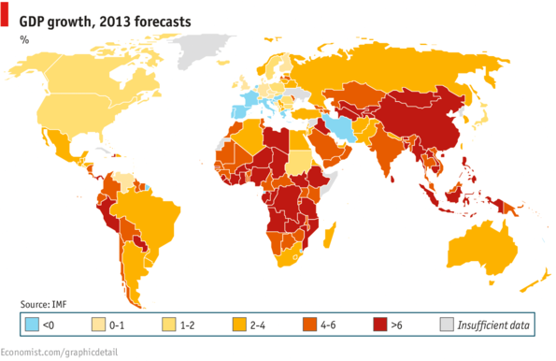
DATA GATHERING
This dataset was build by augmenting dataset will be focusing on the factors that affecting a country's GDP per capita and try to make a model using the data of 227 countries from the database ( reference: Kaggle)

Slide 17
The Data set Used in Our Model include the following Attributes
Deathrate rate of a country
Service
Label-GDP ($ per capita)
Selecting the country name
Selecting the Region
Calculating the Population in the country
Selecting the Area of the Country in (sq. mi.)
Calculating the Population density in (per sq. mi.)
Ratio of the coast per area
Taking Net Migration of the country
Agriculture
Industry
Infant mortality (per 1000 births)
Literacy (%)
Phones (per 1000)
Arable (%)
Crops (%)
Other (%)
Birth rate of a country
Agriculture
Industry
Service
Label-GDP ($ per capita)
Climate

Slide 18
INSIGHTS :
We get the insights about the data using the following functions
df.shape --for the shape of the data
df.describe() -- for the distribution of data.
df.info() -- for the columns and their data types
df.head() -- for the first 5 rows
df.tail() -- for the last 5 rows
df.isnull().sum()—to check the null values in columns

Slide 19
DATA WRANGLING
The dataset should not have any missing values and if the dataset does have missing values, they should be replaced by the appropriate value.
Handling Missing Values:
There are three types to fill missing values
Mean
Median
Mode

Slide 20
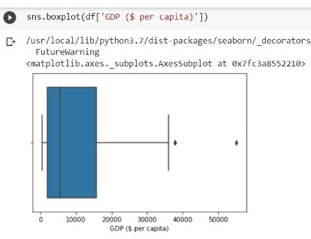
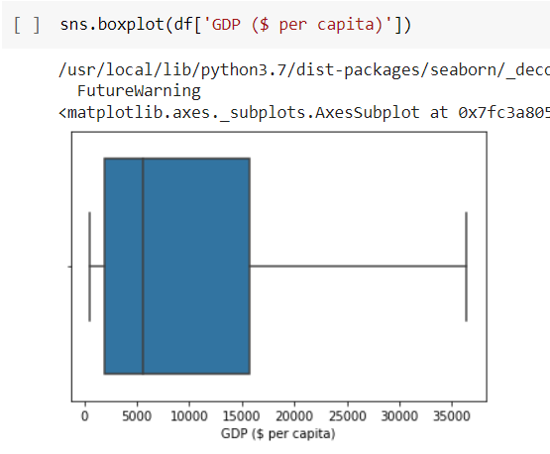
Outlier Treatment:
Outliers can be filled by Percentile and Quantile

Slide 21
EXPLORATORY DATA ANALYSIS

Slide 22
DATA VISUALIZATION
Data Visualization is the process of analyzing data in the form of graphs or maps, making it easier to understand patterns in the data.
There are various types of Visualizations:
✓ UNIVARIATE ANALYSIS
✓ BI-VARIATE ANALYSIS
✓ MULTI-VARIATE ANALYSI

Slide 23
EXPLORATORY DATA ANALYSIS
We will use Matplotlib and Seaborn library for the data visualization.
Some commonly used graphs are
• Bar Plot
•Box Plot
•Hist Plot
Univariate
BIVARIATE
MULTIVARIATE
•Pair Plot
•Heat Map
Hist plot
Scatter plot

Slide 24
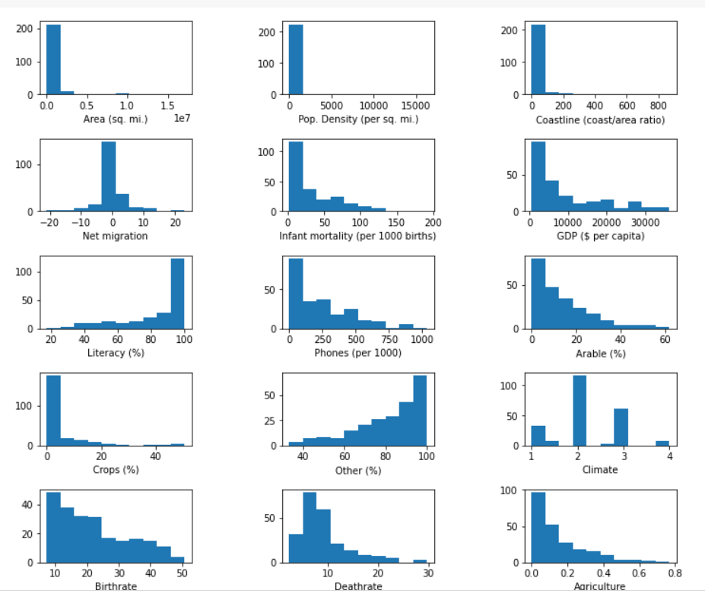
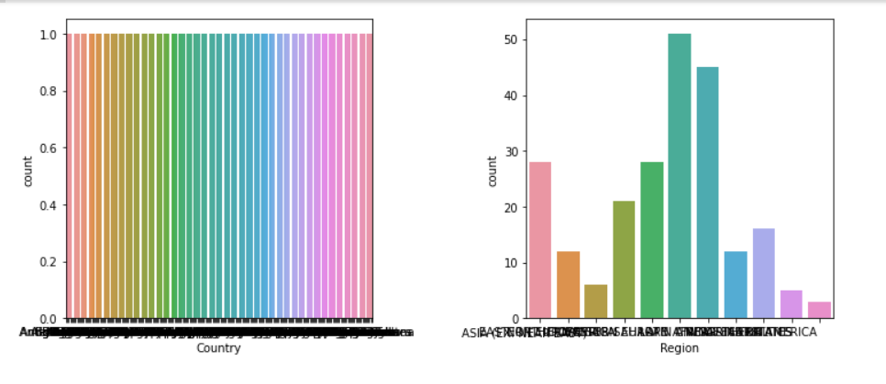
UNIVARIATE FEATURE ANALYSIS:
Univariate the simplest form of analyzing data.
Uni means one, so in other words the data has only one variable. analysis is
NUMERICAL
CATEGORICAL

Slide 25
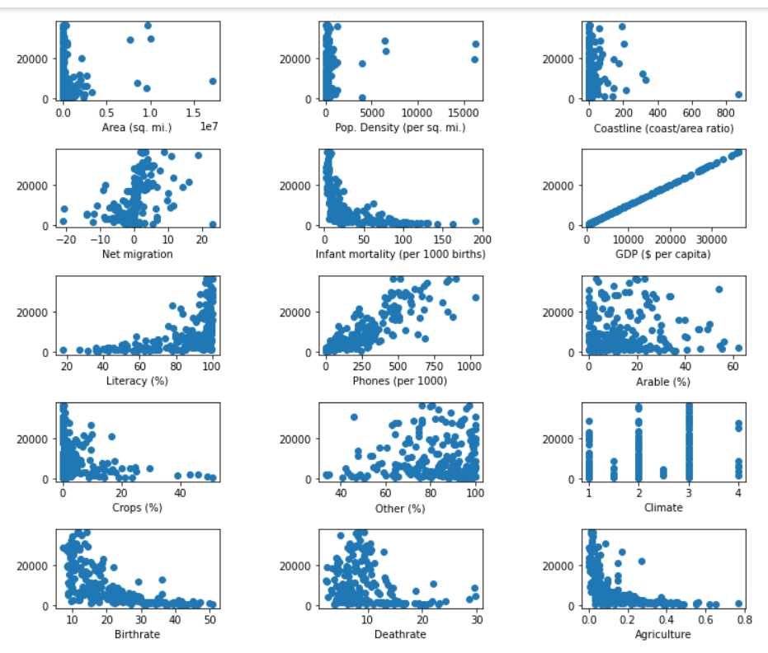
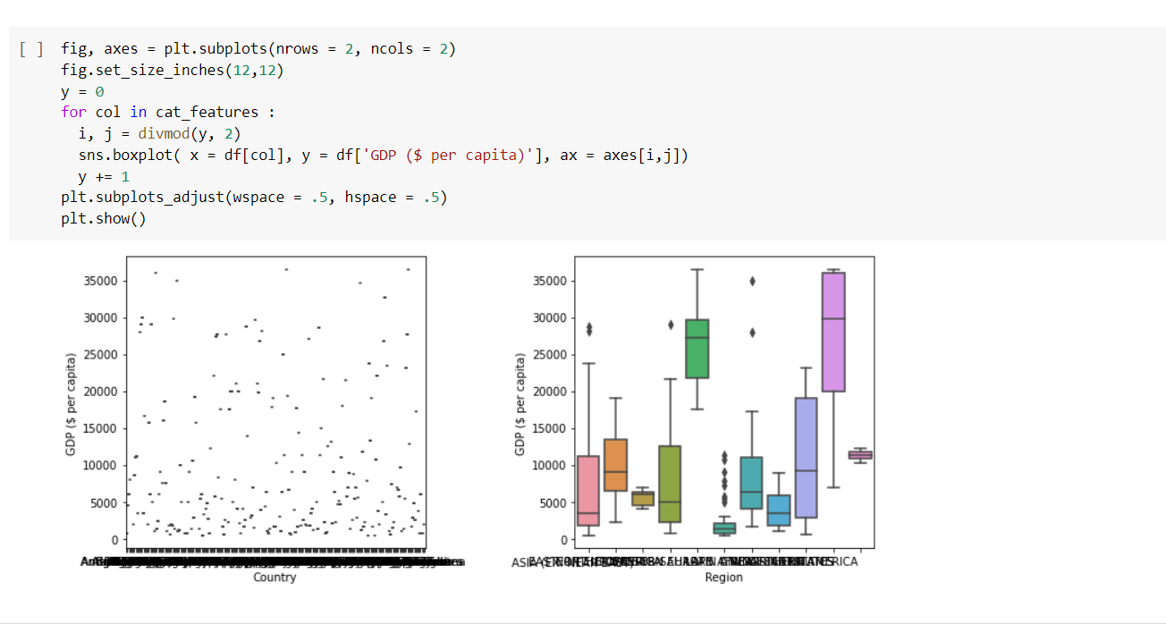
BI-VARIATE FEAUTURE ANALYSIS:
Bivariate analysis is one of the statistical analysis where two variables are observed.
One variable here is dependent while the other is independent.
NUMERICAL
CATEGORICAL

Slide 26
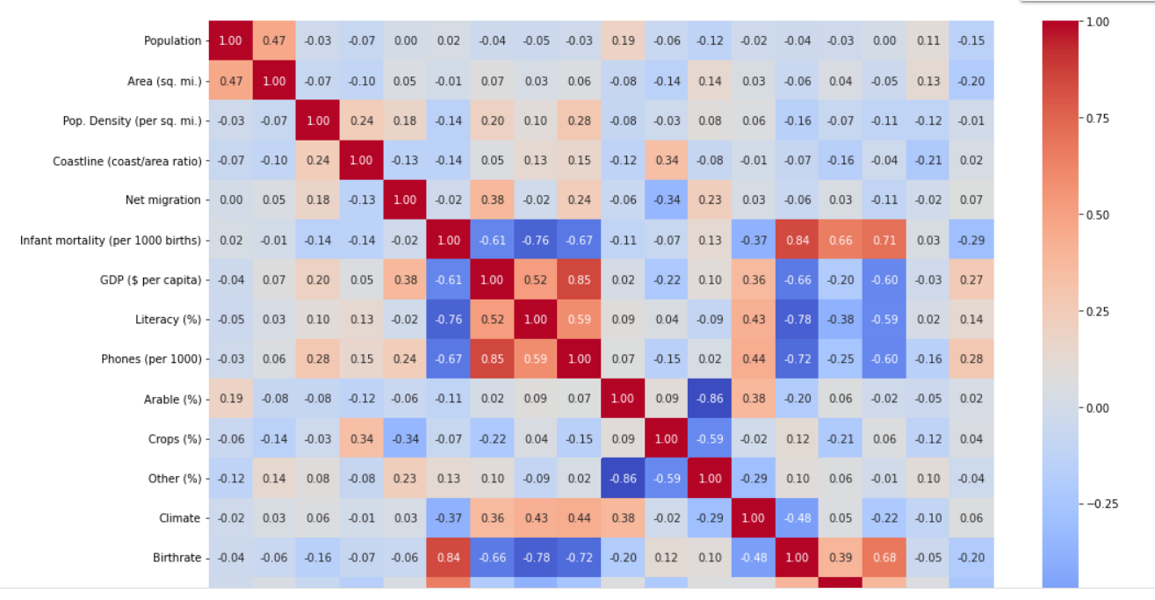
Multivariate Analysis :
CORELATION BETWEEN TWO VARIABLES
The heatmap shows the correlation between all numerical columns.

Slide 27
MODELING

Slide 28
Types of Machine Learning Models :
Supervised Learning : Data with labels
Unsupervised learning : Data without labels
Reinforcement Learning : Sates and actions
Supervised Learning :
Supervised Learning used in Regression and classification.
Regression is used for continuous outcomes
Classification is used for categorical outcomes

Slide 29
FEATURE SELECTION
After performing the data cleaning and visualizations, we implemented our machine learning algorithms on the features of the dataset.
X = independent variables
y = dependent variables
Spliting
The next step is building the machine learning model.
While building the machine learning model, first we need to split our dataset into 2 parts i.e.: training data and test data.
from sklearn.model_selection import train_test_split
X_train,X_test, y_train, y_test = train_test_split(X, y, test_size = .2, stratify =y, random_state=1)

Slide 30
SCALING:
Scaling is a technique to standardize the independent features present in data in a fixed range.
Techniques to perform Scaling are
Standard Scalar
Min-Max Scalar
from sklearn.preprocessing import StandardScaler
my_scalar = StandardScaler()
X_train_scaled= my_scalar.fit_transform(X_train)
X_test_scaled= my_scalar.transform(X_test_scaled , y_test)

Slide 31
Linear
Regression
Support
Vector
Machine
Supervised Learning Algorithms
Decision
Tree
Regressor
Random
Forest
regressor

Slide 32
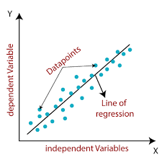
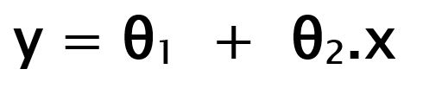
Linear Regression:
Linear Regression is a machine learning algorithm based on supervised learning. It performs a regression task. Regression models a target prediction value based on independent variables.
Linear Regression Formula:
While training the model we are given : x: input training data y: labels to data (supervised learning)
θ₁: intercept θ₂: coefficient of x

Slide 33
Gradient Descent
To update θ₁ and θ₂ values in order to reduce Cost function (minimizing RMSE value) and achieving the best fit line the model uses Gradient Descent. The idea is to start with random θ₁ and θ₂ values and then iteratively updating the values, reaching minimum cost.
Syntax:
from sklearn.linear_model import LinearRegression
model_linear=LinearRegression()
model_linear.fit(X_train_scaled,y_train)
linear = model_linear.score(X_test_scaled,y_test)

Slide 34
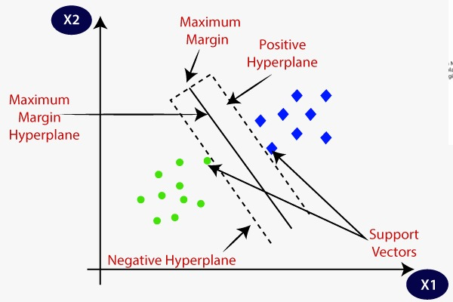
SUPPORT VECTOR MACHINE(SVM):
In machine learning, support vector machines (SVMs, also support vector networks) are supervised learning models with associated learning.
A Support Vector Machine (SVM) is a discriminative regressor formally defined by a separating hyperplane.
They are two types:
Linear SVM – It is used when data is linearly separable
Non Linear SVM – It is used when data is not linearly separable

Slide 35
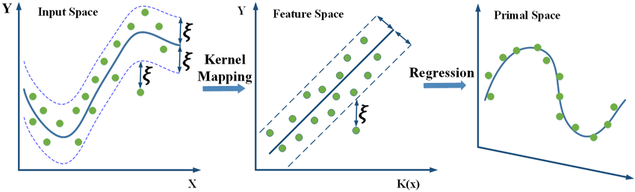
By using Kernel, converting lower dimension data into higher dimension data
Syntax:
from sklearn import svm
model_svm = svm.SVR()
model_svm.fit(X_train_scaled,y_train)
svm=model_svm.score(X_test_scaled, y_test)

Slide 36

Decision Tree Regression
Decision tree builds regression or classification models in the form of a tree structure.
It breaks down a dataset into smaller and smaller subsets while at the same time an associated decision tree is incrementally developed.
The final result is a tree with decision nodes and leaf nodes.

Slide 37
In decision tree each split minimize the impurity
To calculate impurity of nodes:
Gini = 1-Σ(Pi)^2
Entropy = 1-ΣPi log₂ Pi
Information Gain =parent node entropy – Σweighted entropy of child nodes
SYNTAX:
from sklearn.tree import DecisionTreeRegressor
model_decision = DecisionTreeRegressor(random_state = 100,
max_depth = 3,
min_samples_leaf = 3)
model_decision .fit(X_train, y_train)
decisiontree = model_decision.score(X_test, y_test)

Slide 38
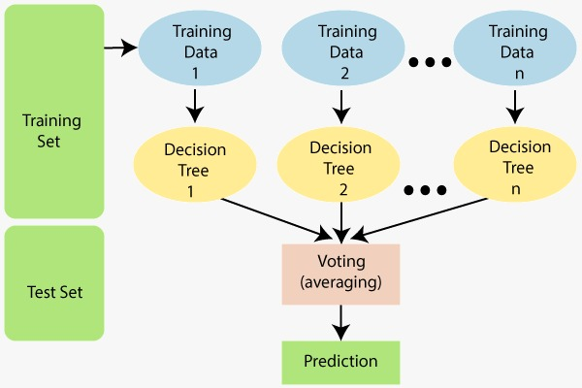
RANDOM FOREST ALGORITHM
Random Forest is a supervised ensemble machine learning algorithm used in both classification as well as regression problems.
It contains various decision trees and an average of it is taken so as to give the output.
Random forest is useful in reducing the effect of over fitting and hence giving a more accurate output.
SYNTAX:
from sklearn.ensemble import RandomForestRegressor
model_rfr = RandomForestRegressor(n_estimators = 50,
max_depth = 6,
min_weight_fraction_leaf = 0.05,
max_features = 0.8,
random_state = 42)
model_rfr.fit(X_train, y_train)

Slide 39
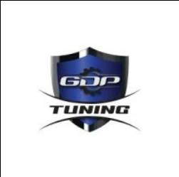
PERFORMANCE TUNING

Slide 40
METRICS:
Evaluation metrics are a measure of how good a model performance and how well it approximates the relationship.
There are three error metrics that are commonly used for evaluating and reporting the performance of a regression model.
They are :
MEAN SQUARED ERROR(MSE)
MEAN ABSOLUTE LOG ERROR(MAE)
R2 SCORE

Slide 41
Metrices:
Performances metrices are a part of every machine learning pipeline.
They tell you if you’re making progress , and put a number on it.
All machine learning models , whether it’s Random Forest.

Slide 42
Mean squared log error:
Mean squared logarithmic error (MSLE)can be intrepreted .
Measured of the ratio between the true and predicted values .
Mean squared logarithmic error is, as the name suggests , a
variation of the mean squared error.

Slide 43
Mean Squared Error:
The MSE error tells you how close a regression line is a set of points .It does this by taking the distances from the points to the regression line (these distances are the “errors”) and squaring them .
The squaring is necessary to remove any negative signs.
mse = mean_squared_error(y_test,y_predict)

Slide 44
Mean Absolute Error:
Mean absolute error (MAE) is a loss function used for regression.
mae= mean_absolute_error(y_test,y_predict)
Formula:
Mean Absolute Error = (1/n) * ∑|y_{i} – x_{i}|
where,
Σ = Greek symbol for summation
Y_{i} = Actual value for the ith observation
X_{i} = Calculated value for the ith observation
N = Total number of observations

Slide 45
Method 1: Using Actual Formulae
Mean Absolute Error (MAE) is calculated by taking the summation of the absolute difference between the actual and calculated values of each observation over the entire array and then dividing the sum obtained by the number of observations in the array.
Method 2: Using sklearn
sklearn.metrics module of python contains functions for calculating errors for different purposes. It provides a method named mean_absolute_error() to calculate the mean absolute error of the given arrays.
Syntax:
mean_absolute_error (actual , calculated)

Slide 46
R2 score:
Coefficient of determination also called as R² score is used to evaluate the performance of a linear regression model.
It is the amount of the variation in the output dependent attribute which is predictable from the input independent variable(s).
Mathematical Formula :
R²= 1- SS_{res} / Ss_{total}
_{Where,}
SS_{res} is the sum of squares of the residual error
SS_{tot} is the total sum of the errors.

Slide 47
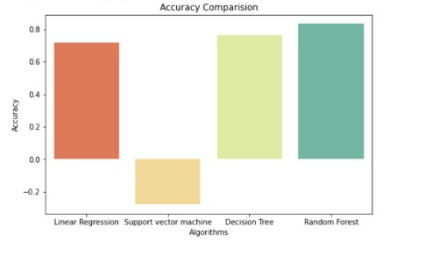
Accuracy Comparision
------Model------ ----Accuracy----
Linear Regression : 0.7193410226387175
SVM : -0.2795418945328405
Decision Tree Regressor : 0.763134317159072 Random forest Regressor : 0.8339409551245313

Slide 48
DEPLOYMENT

Slide 49
DEPLOYMENT
We developed a web application with simple user interface to end user to use our model to predict the GDP in his location or countries.
TOOLS USED
Frontend Tools: HTML,CSS&BOOTSTRAP.
Backend Tools: Python, Web Framework: Flask

Slide 50
SET UP PROJECT
To setup the project.
pip install virtualenv
Create the virtual environment
virtualenv my_venv (Name of virtual environment)
Activate the virtual environment,
my_venv/scripts/activate
Install the flask , scikit learn , numpy
pip inatall flask

Slide 51
DEPLOYMENT
Now create an app that hosts the application.
app = Flask(__name__)
Then you need a route that calls a Python function. A route maps what you type in the browser (the url)to a Python function.
@app.route(‘/’)
def index():
To run the application use the below code
app.run(debug=True)
page
App.py
Python
Flask
Jinja
input
data
data
template
Index.html

Slide 52
DEPLOYMENT
To Deploy the project in the CLOUD, we are using HEROKU Platform.
Heroku is a platform as a service (PaaS) that enables developers to build, run, and operate applications entirely in the cloud.
To Deploy the Project Using Heroku we need to follow the following Steps.
In the terminal go to Project Location and install the gunicorn which is a python
Now go to your Folder and Create the folder Procfile without extensions.
In Terminal use this commands pip freeze > requriements.txt .
Install the Git and HerokuCli in your system.
Now Initialize the git in terminal. To initialize use git init
To add files use git add .
Commit the git git commit -m “msg”

Slide 53
DEPLOYMENT
Login into Heroku, use
Heroku login
Now create the application using
Heroku create AppName
Add a remote to your local repository
heroku git:remote –a AppName
Push the files to Heroku
git push heroku master
Now application is deployed into the cloud.

Slide 54
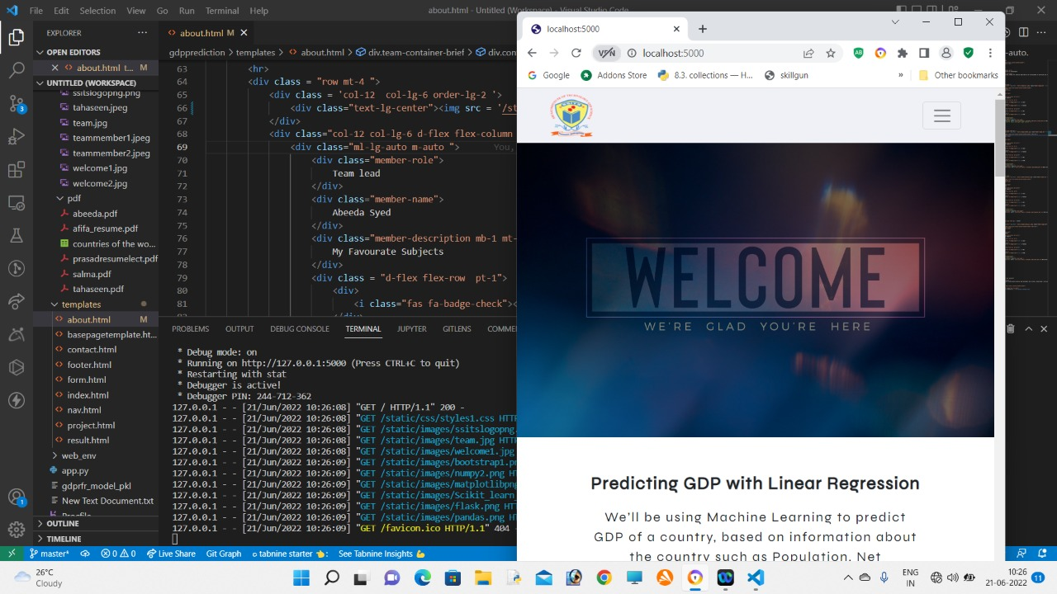
WELCOME PAGE

Slide 55
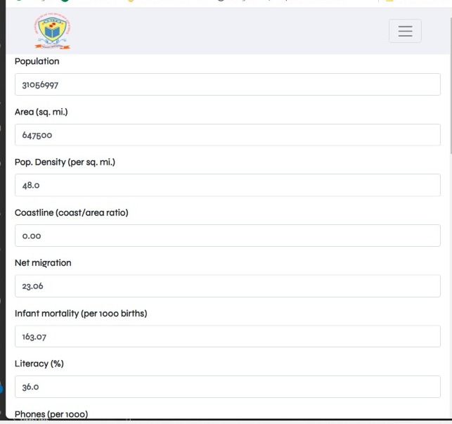
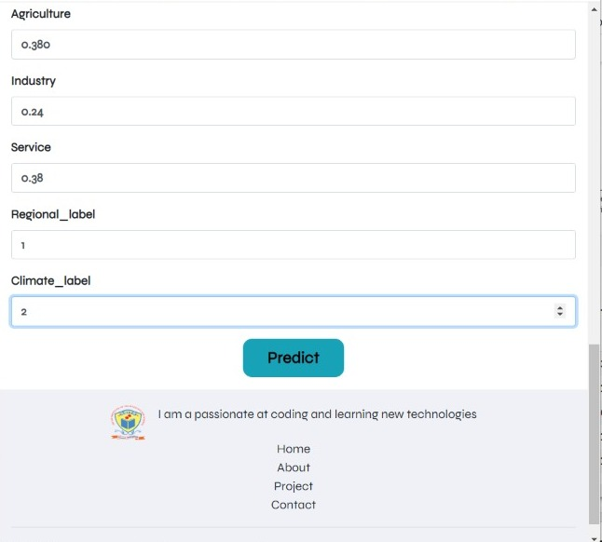
DEPLOYMENT
Form page for giving the input values

Slide 56
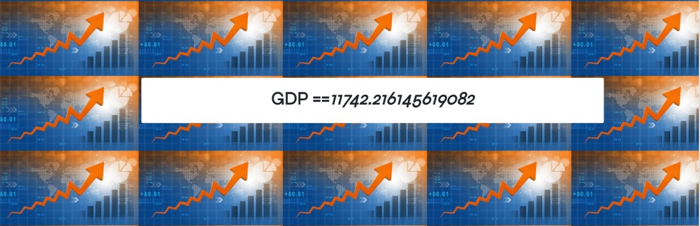
After putting the values by the user , we get the results of the model in the way mentioned below

Slide 57
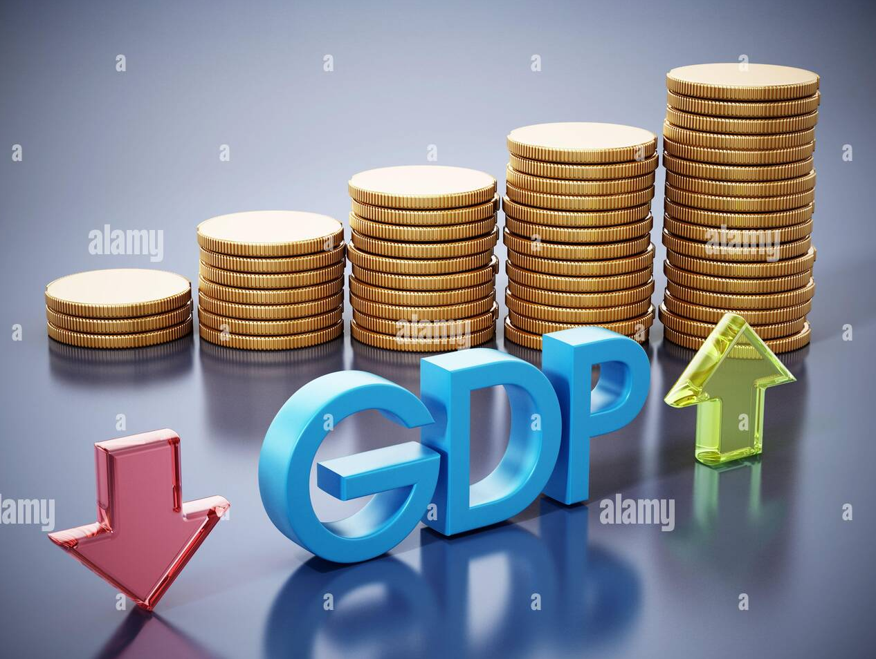
FUTURE SCOPE
This study encourages increasing the use of machine learning models in macroeconomic forecasting.
This applicant can be implemented as a mobile app and be made available free for the business to download which they can use it to predict the GDP of a country where the can buy shares in that location.

Slide 58
CONCLUSION
We have made this project to business improvements to use the current technology instead of relying on old methods.
Using machine learning algorithms, we trained the model with 4 following algorithms namely linear regression, Decision Tree, SVM & Random Forest. And we got highest accuracy of 83% with Random Forest Model and is effectively satisfying the work of predicting future movement of GDP of country with given data .

Slide 59
THAnk’s
FROM
S.AFIFA
S.TAHASEEN
S.ABEEDA
S.UMMESALMA

